Slide 1


SHRI VILEPARLE KELAVANI MANDAL’S
SHRI BHAGUBHAI MAFATLAL POLYTECHNIC
INFORMATION TECHNOLOGY DEPARTMENT
COURSE: ADVANCED WEB TECHNOLOGY CODE: AWT190918
SEMESTER: VI
ACADEMIC TERM: 24 JAN 2023 TO 12 MAY 2023

Slide 2
COURSE OUTCOMES
CO1. Use various tools used in dynamic web page designing & hosting of Web sites
CO2. Use GUI tools of .net framework
CO3. Use basic and advance .net controls
CO4. Build applications integrated with .net Framework
CO5. Apply Database Controls to establish database connectivity
.

Slide 3
File Handling with C#
Mr. M.R. Solanki
Sr. Lecturer, Information Technology Department
manish.solanki@sbmp.ac.in
SBMP

Slide 4
COURSE OUTCOME COVERED BY THE SESSION
CO2: Use GUI tools of .net framework
AIM: Implement a program to open a text file , write student records, save and edit using C# windows form
LAB OUTCOMES:
Students will be able to:
Execute different I/O operations of files in C#.net
Design and Develop a GUI form to perform to perform arithmetic operation(s)
Implement a program to modify the content of a file using GUI controls

Slide 5

File
A file is a collection of data or information stored in disk with a specific name and directory path.
The created file has properties like the date (when it got created), size, path (where it saved), etc. When you read or write the data to a file, then it becomes a stream.
stream means, a communication medium through which the sequence of byte passes.
C# supports file handling through the classes in the System.IO namespace.
We can perform read, write, delete and append operations on files

Slide 6
File operations

Slide 7
Stream Classes
Classes | Description
FileStream | This class provides a Stream for a file, supporting both synchronous and asynchronous read and write operations.
StreamReader | This class implements a TextReader that reads characters from a byte stream
StreamWriter | This class implements a TextWriter for writing characters to a stream

Slide 8

StreamWriter class provides WriteLine() method to write data to the file in string form
StreamReader class provides ReadLine() method to read data from the file in string form.

Slide 9
Stream Classes
Classes | Description
TextReader | This class represents a reader that can read a sequential series of characters.
TextWriter | This class represents a writer that can write a sequential series of characters.
BinaryReader | This class reads primitive data types as binary values
BinaryWriter | This class writes primitive types in binary to a stream

Slide 10
Writing to and read text data from a File
FileStream fo = new FileStream("e:\\file3.txt", FileMode.OpenOrCreate);
StreamWriter sw = new StreamWriter(fo);
Console.WriteLine("Enter the string. null for termination");
while (true)
{
String str=Console.ReadLine();
if(string.IsNullOrEmpty(str))
break;
sw.WriteLine(str);
}
sw.Flush();
fo.Close();

Slide 11
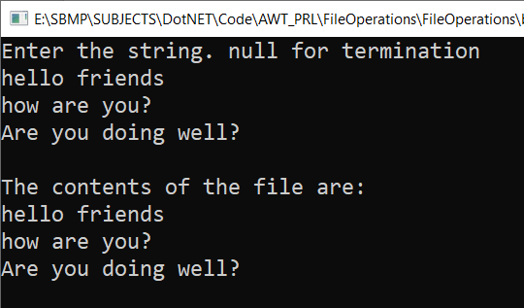
Writing to and read text data from a File
FileStream fi = new FileStream("e:\\file3.txt", FileMode.OpenOrCreate);
StreamReader sr = new StreamReader(fi);
string str1;
Console.WriteLine("The contents of the file are:");
while ((str1 = sr.ReadLine()) != null)
{
Console.WriteLine(str1);
}
sr.Close();
fi.Close();
Console.ReadKey();

Slide 12
Appending the content to the file
StreamWriter sw = File.AppendText("f:\\file3.txt");
Console.WriteLine("Enter the string. null for termination");
while (true)
{
String str=Console.ReadLine();
if(string.IsNullOrEmpty(str))
break;
sw.WriteLine(str);
}
sw.Flush();
fo.Close();

Slide 13
File Operation Modes
FileMode parameters control whether a file is overwritten, created, opened, or some combination thereof.
Use Open to open an existing file. To append to a file, use Append. To truncate a file or create a file if it doesn't exist, use Create.

Slide 14
Practice Exercises
Q1: Create a file graphically (using Windows interface), write some content. Open this file in a C# program in append mode and save some text into it.
Q2: Write a C# program to copy the content of one file to another file.
NOTE: Implement program for both text and binary files
FileStream has WriteByte() and ReadByte() methods

Slide 15
Solution
FileStream fi = new FileStream("e:\\bird.jpg", FileMode.OpenOrCreate);
FileStream fo = new FileStream("e:\\MyDir1\\bird.jpg", FileMode.OpenOrCreate);
int i;
while ((i = fi.ReadByte()) != -1)
{
fo.WriteByte((byte)i);
}
fi.Close();
fo.Close();
Console.ReadKey();

Slide 16
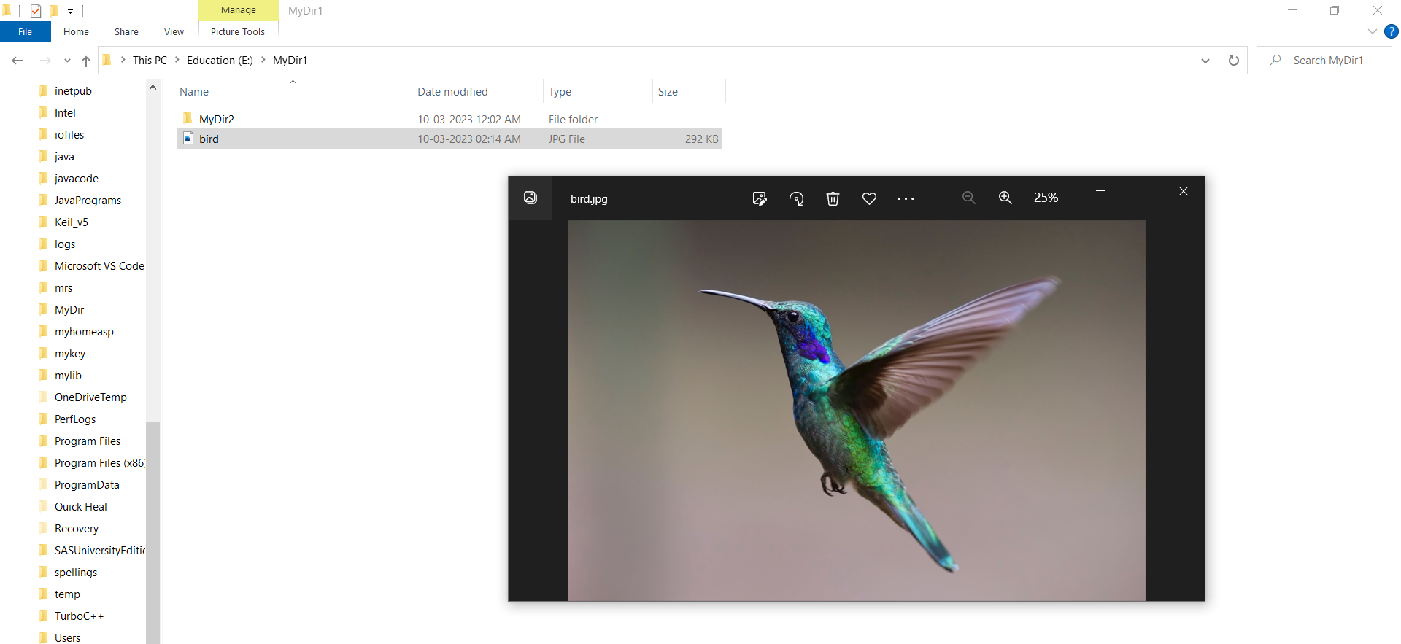

Slide 17
TextWriter & TextReader classes are used to handle text data
using(TextWriter tw = File.CreateText("e:\\file.txt"))
{
tw.WriteLine("C# File Handling");
tw.WriteLine("TextReader Class and TextWriter Class");
}
using (TextReader tr = File.OpenText("e:\\file.txt"))
{
Console.WriteLine(tr.ReadToEnd());
}
Console.ReadKey();

Slide 18
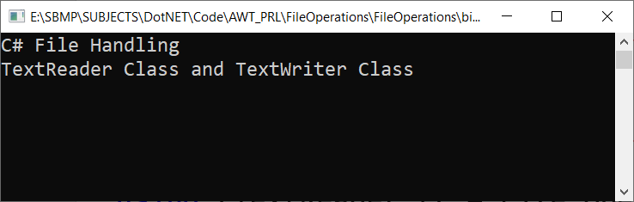

Slide 19
Creating a GUI application using Forms

Slide 20
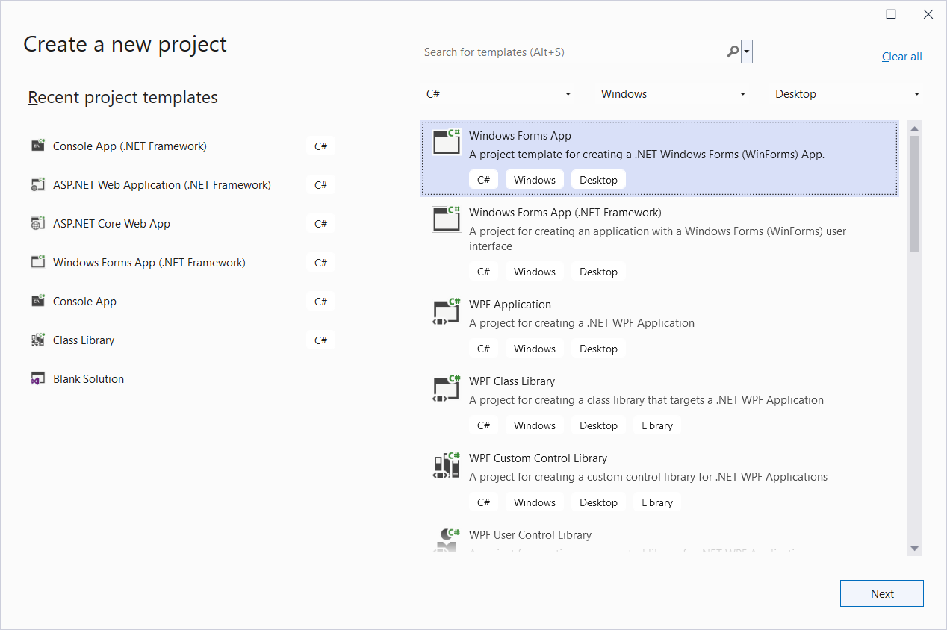

Slide 21
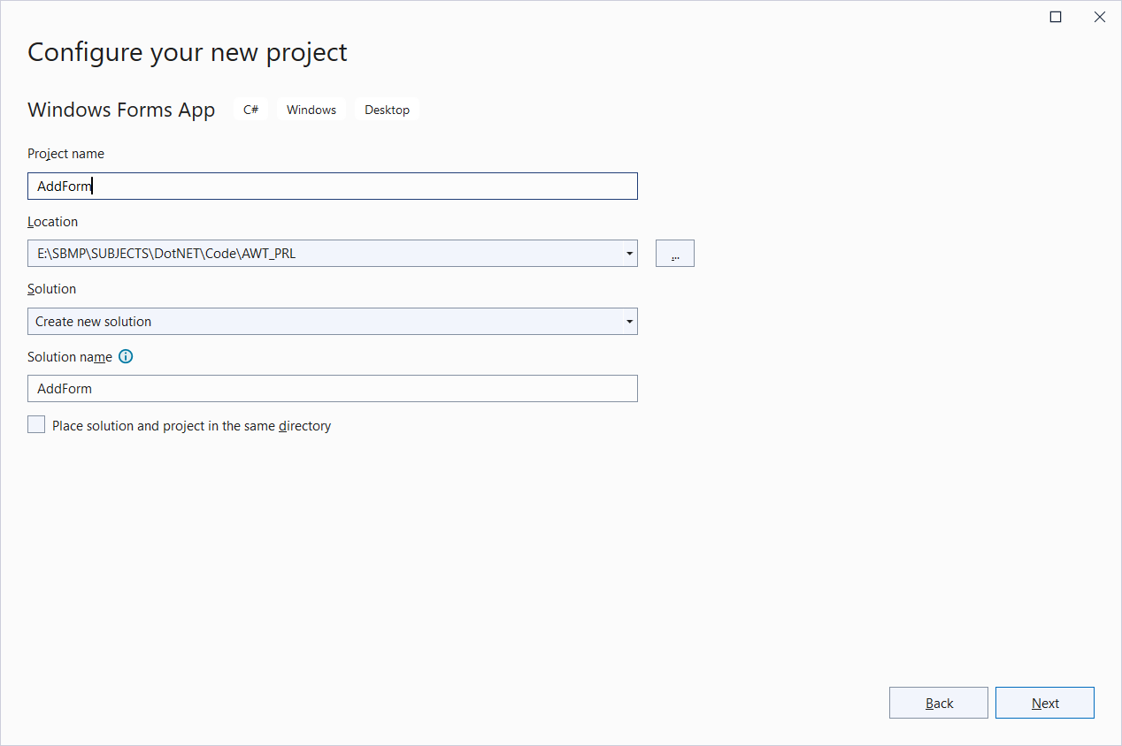

Slide 22
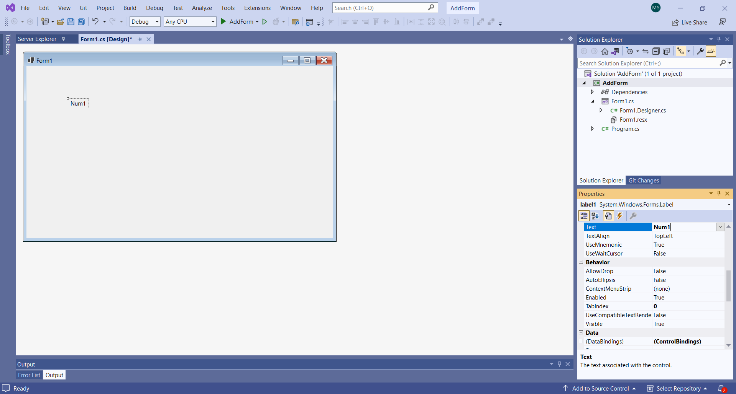
Select the “Label” control from the “Toolbox” toolkit

Slide 23
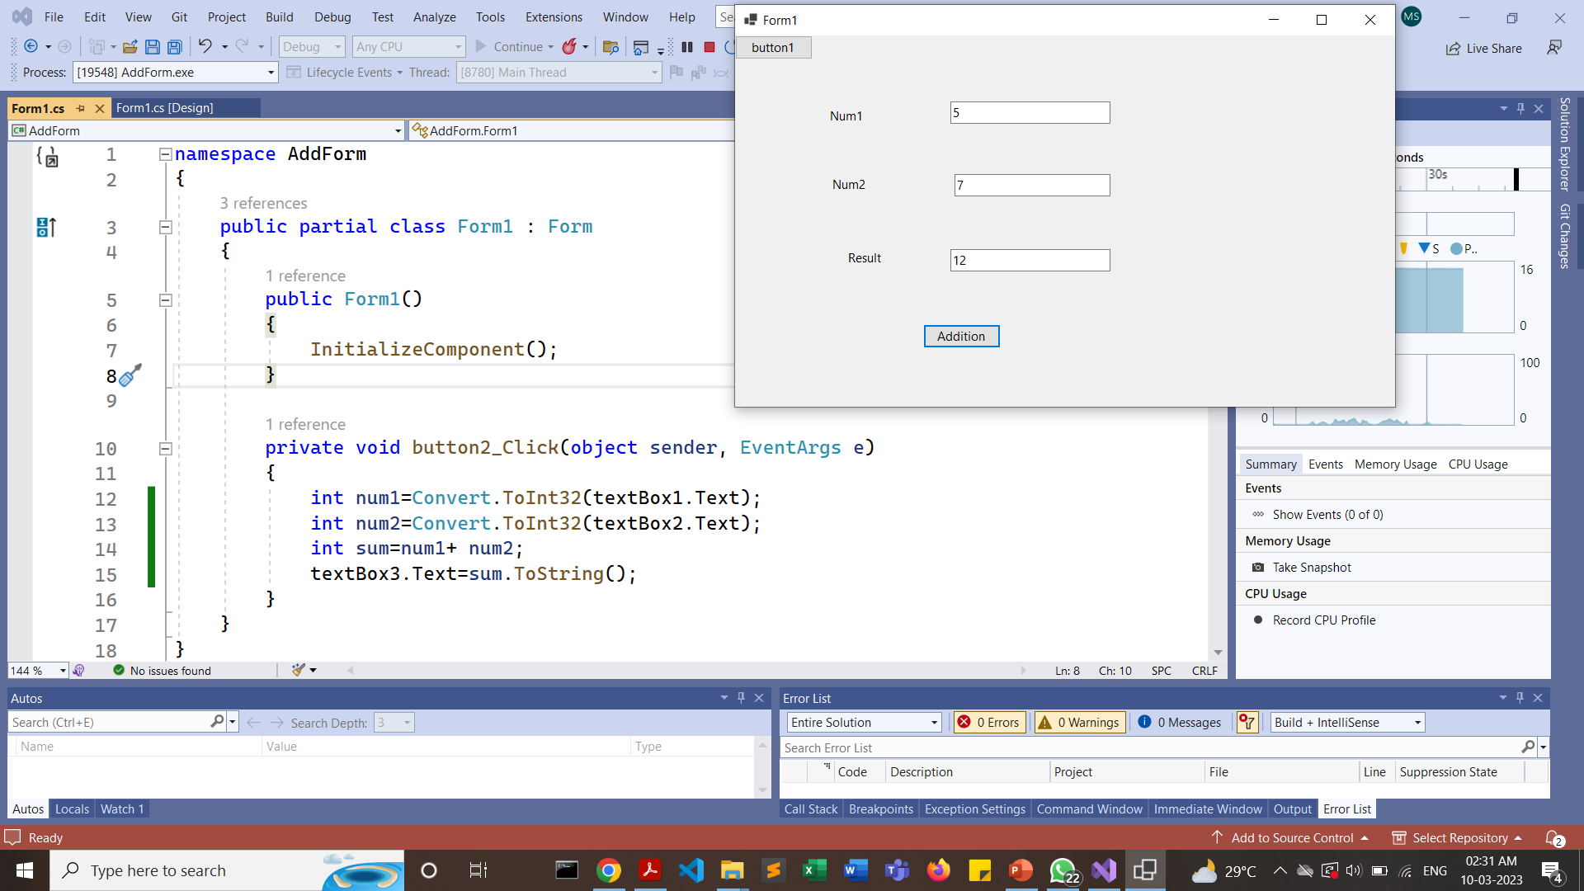
Addition of 2 numbers

Slide 24
Practice Exercise
Q3. Design a form based GUI having a textbox, write some lines in it and as user presses “AddToFile” button, the content should be appended to the File.

Slide 25
Conclusion
Can you execute different I/O operations of files in C#.net?
Can you Design and develop a GUI form to perform arithmetic operations?
Are you able to implement a program to modify the content of a file using GUI controls?

Slide 26
Credits
[1] https://www.knowledgehut.com/tutorials/csharp/csharp-file-handling
[2] https://www.geeksforgeeks.org/basics-of-file-handling-in-c-sharp/
[3] https://www.studytonight.com/post/csharp-file-handling

Slide 27


